Slide 1
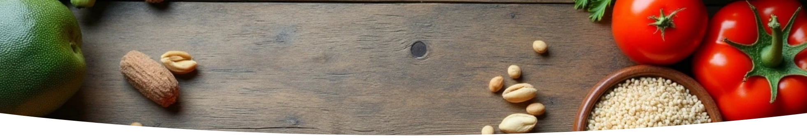

Food Analysis System
Prepared |By: Lawrencia Archer

Slide 2

CONTENTS
Prepared By: Lawrencia Archer
1. Top Five Foods with the Highest Greenhouse Gas Emissions Per 100g of Protein
2. Land Use Between Plant-based and Animal-based Foods
3. Top Five Foods with the Highest Water Usage
4. The Five Foods with the Least Greenhouse Gas Emissions
5. Top Five Foods with the Highest Total From Farm and Animal Feed
6. Top Five Foods with the Highest Total from Packaging and Transport
7. Top Five Foods with the least Impact on the envirinment.
Final Insights
Overview of Methods Used

Slide 3


01
Top Five Foods with the Highest Greenhouse Gas Emissions Per 100g of Protein

Slide 4
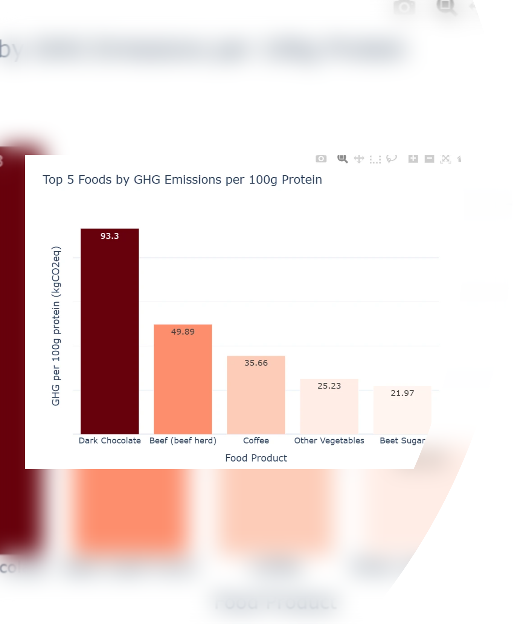

Conclusion:
Dark chocolate and Beef (beef herd): have a disproportionately high environmental footprint.

Slide 5

02
Land Use Between Plant-based and Animal-based Foods

Slide 6
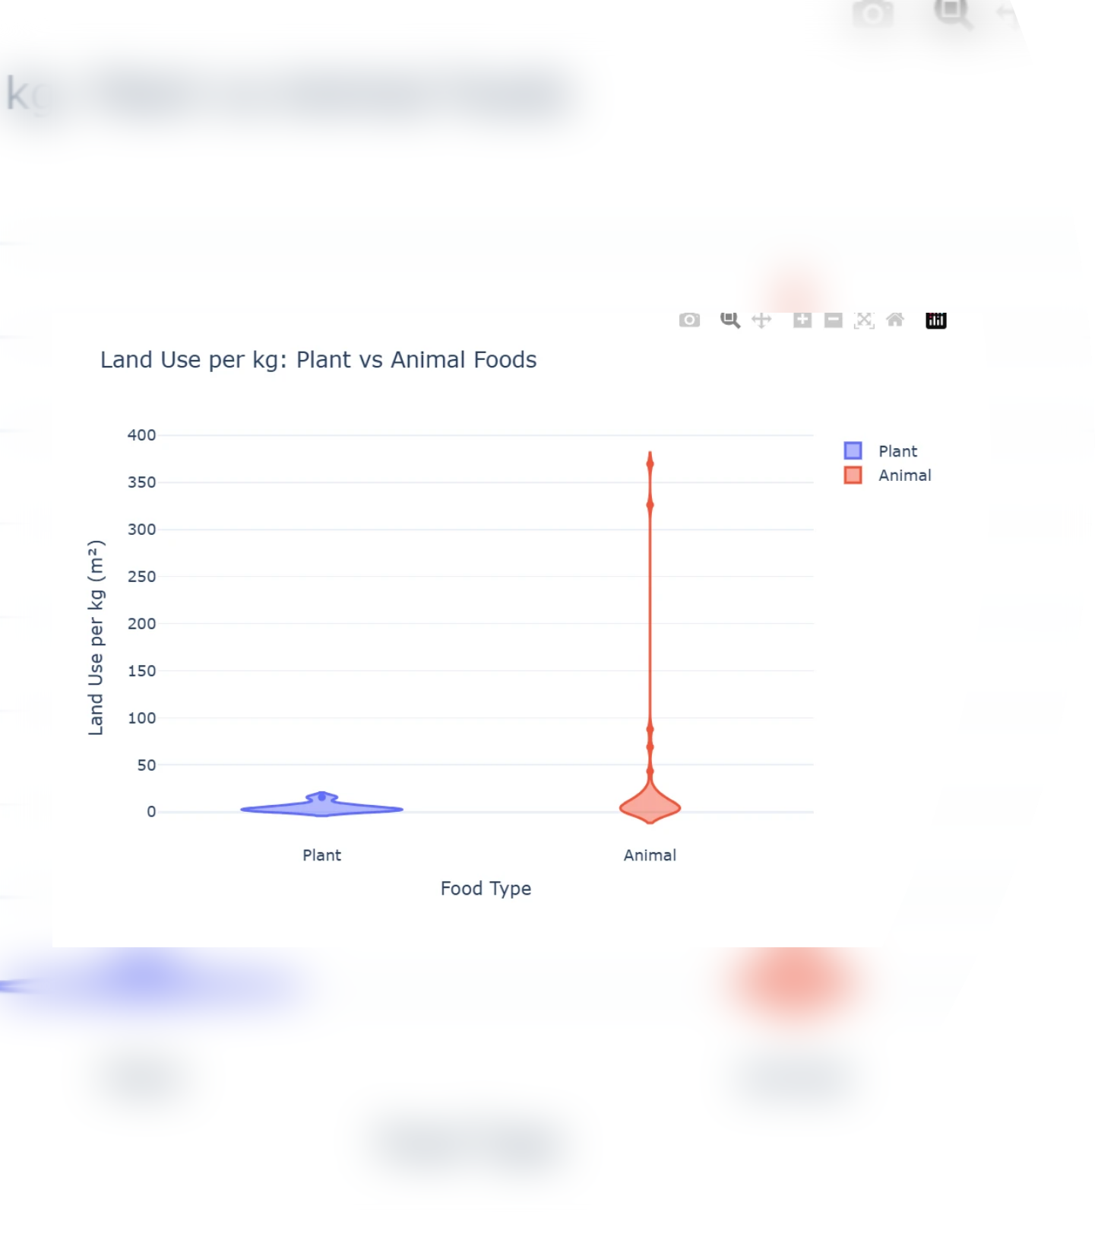



Conclusion:
1
Animal-based foods require more land per kilogram of food
produced.
2
Plant-based foods have minimal land use.

Slide 7

03
Top Five Foods with the Highest Water Usage

Slide 8
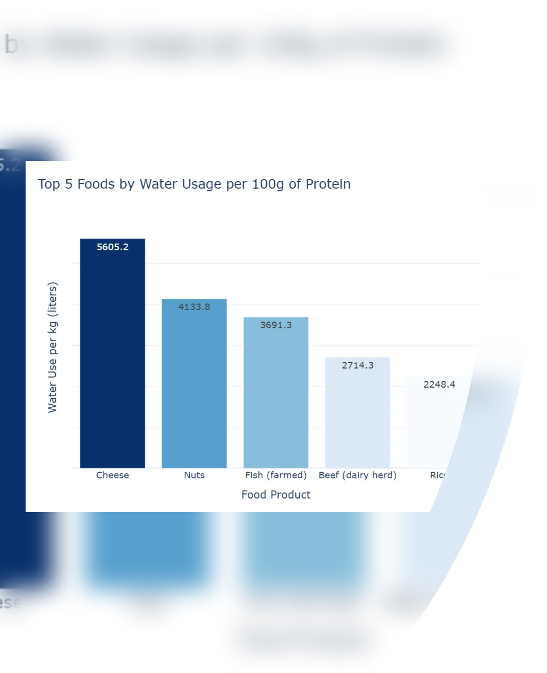

Conclusion:
Cheese and nuts require thousands of liters of water per 100g of protein.

Slide 9

04
The Five Foods with the Least Greenhouse Gas Emissions

Slide 10
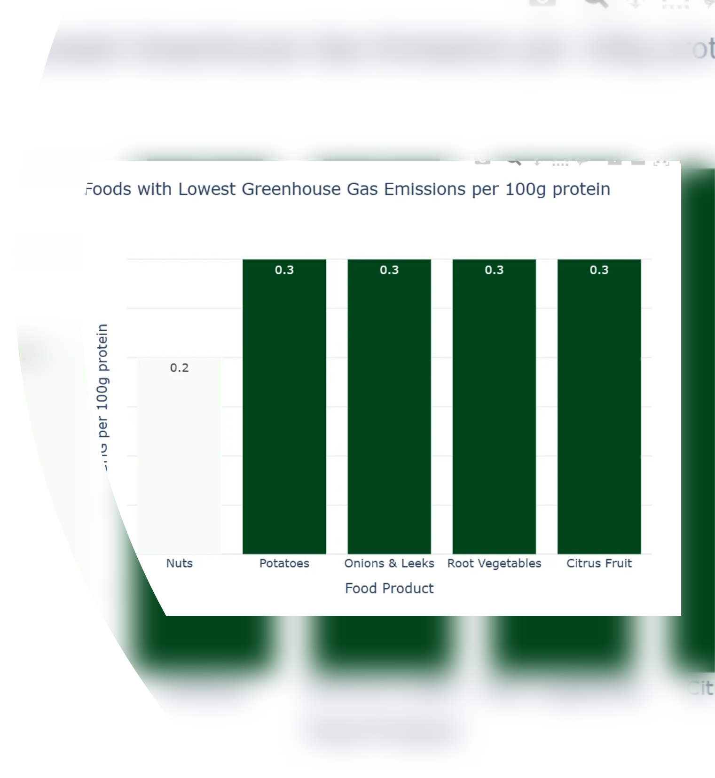

Conclusion
Nuts have the lowest greenhouse gas emissions, followed by potatoes, onions, and leeks.

Slide 11

05
Top Five Foods with the Highest Total From Farm and Animal Feed

Slide 12
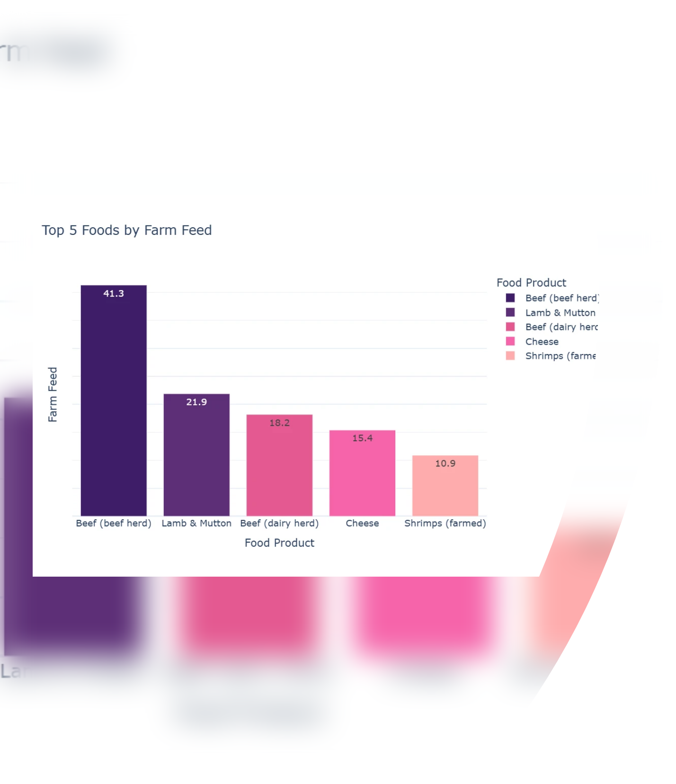

Conclusion
Beef (beef herd) and lamb and mutton topped for to farm and animal feed foods.

Slide 13

06
Top Five Foods with the Highest Total from Packaging and Transport

Slide 14
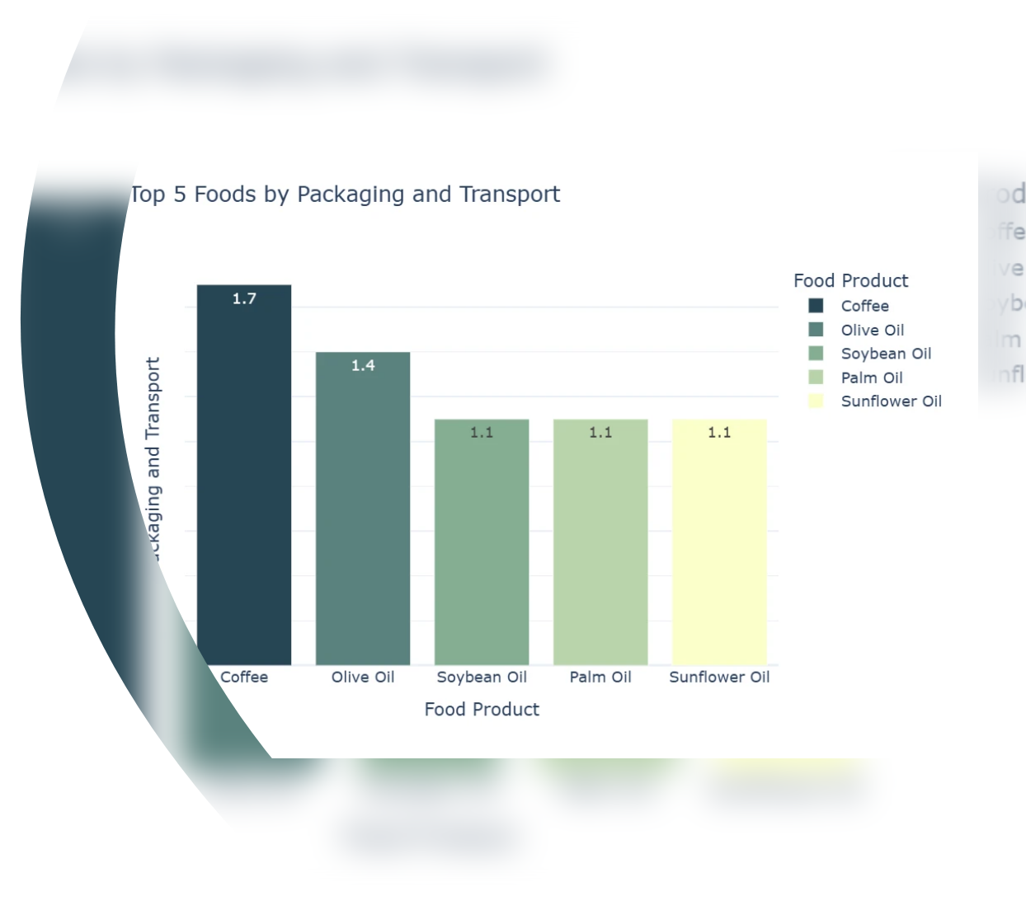

Conclusion
Coffee and olive oil topped in terms for packing and transport.

Slide 15

07
Top Five Foods with the least Impact on the environment

Slide 16
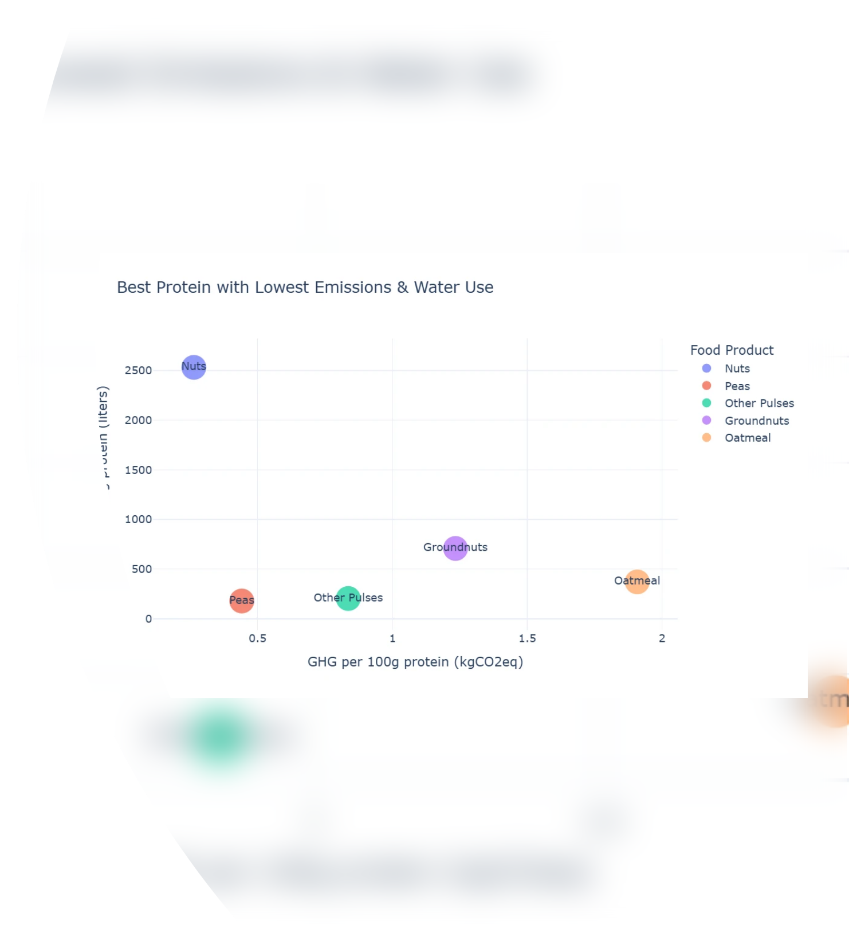

Top Five Foods with the least impact on the environment.
Conclusion
Nuts and Peas are the best protein if you are looking food that has lowest greenhouse gas emission and water usage.

Slide 17
Final Insights

Slide 18



Final Insights
Environmental Footprint:
• Choosing specific food items can significantly impact personal carbon footprint.
• Water scarcity requires not only dietary changes but also improvements in irrigation efficiency and sustainable farming practices for water-intensive crops.
Property Interactions:
• Certain properties and items dominate interactions, highlighting key products that attract more visitors.
• Monitoring low-interaction items can help identify opportunities for promotion and optimization.
Item Interaction:
• Seasonal trends are evident, informing marketing strategies or inventory management.

Slide 19

Overview of Methods Used

Slide 20


Overview of Methods Used
1. Data Loading and Preprocessing
2. Exploratory Data Analysis and Visualization
• Tools Used: Pandas, Sklearn
• Tools Used: Plotly
• Steps:
• Visualization Created:
• Changing long column names.
• Bar charts
• Filling null values using KNN imputation.
• Violin and swan plots
• Replacing spaces in column names with
underscores (_).
• Scatter plots
• Shortening longer names for easier analysis.
Link to GitHub: https://github.com/llawlaw23/Food_Production_Analysis

Slide 21

Thank You

